Slide 1
Task 1:-Sales Prediction using Python
Name:-Bushra Akram Salmani
Oasis Infobyte intership

Slide 2
Introduction
Content:
Short explanation of sales prediction:
“Predicting how much of a product people will buy based on advertising spend, target segment, and platform. Businesses use this to plan marketing strategies and forecast revenue.”

Slide 3
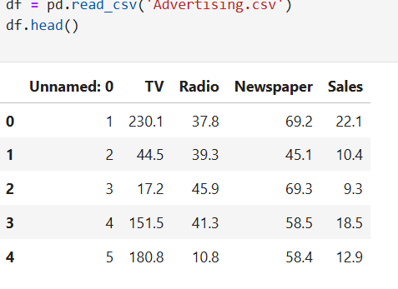
Dataset Overview

Slide 4
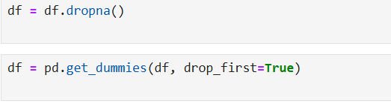
Data Cleaning

Slide 5

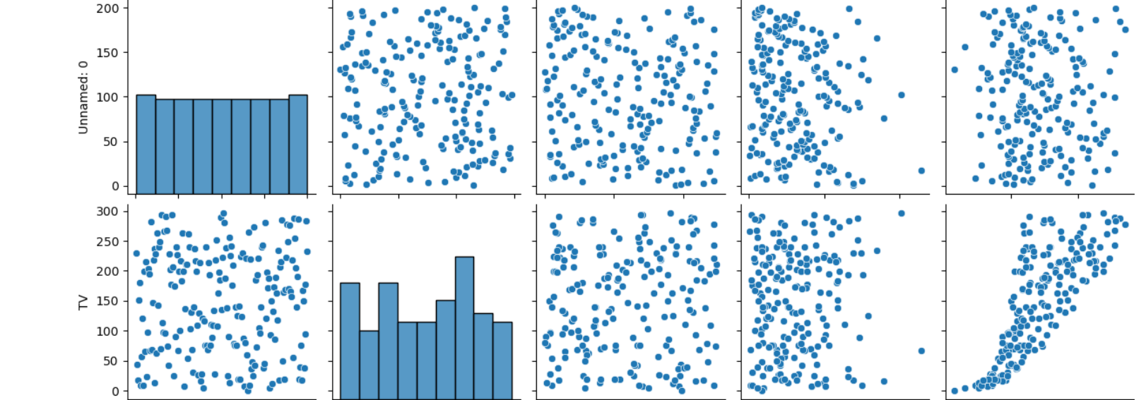
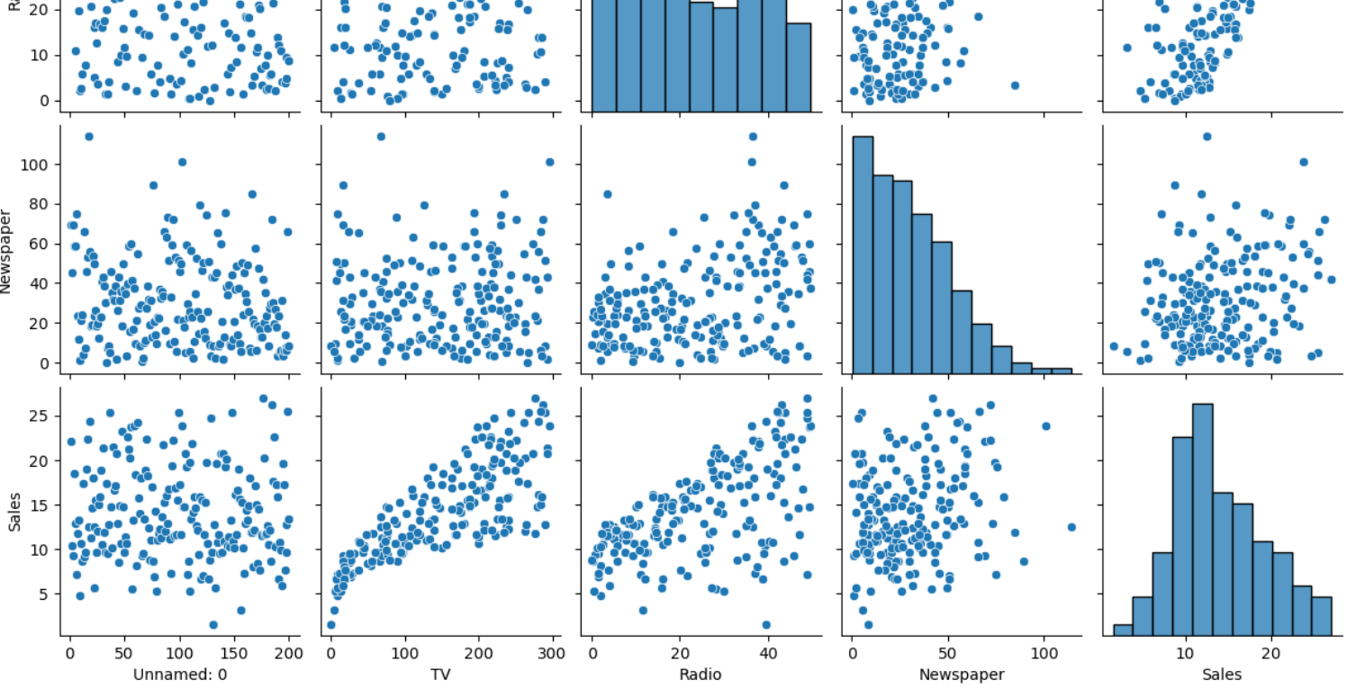
Exploratory Data Analysis (EDA)

Slide 6
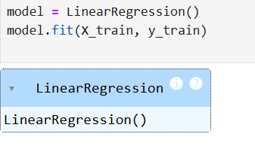
Model Training

Slide 7
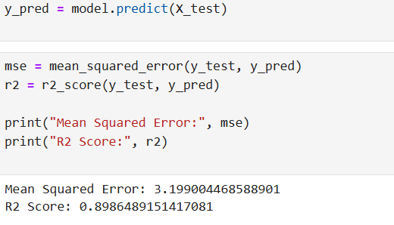
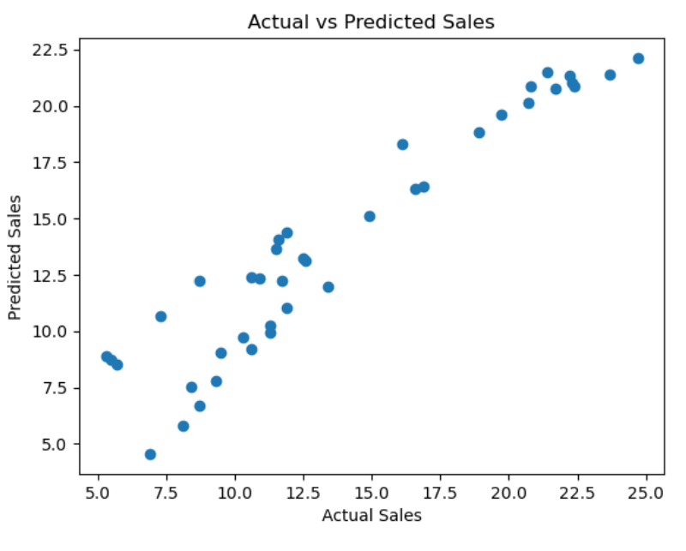
Results

Slide 8
Conclusion
Content:
ML helps predict future sales and optimize marketing spend.

